Slide 1
C++ Programming: From Problem Analysis to Program Design, Fifth Edition
Chapter 1: An Overview of Computers and Programming Languages
*Updated by: Malak Abdullah

Slide 2
The Evolution of Programming Languages (cont'd.)
High-level languages include Basic, FORTRAN, COBOL, Pascal, C, C++, C#, and Java
Compiler: translates a program written in a high-level language machine language
C++ Programming: From Problem Analysis to Program Design, Fifth Edition
‹#›

Slide 3
Processing a C++ Program
#include <iostream>
using namespace std;
int main()
{
cout << "My first C++ program." << endl;
return 0;
}
Sample Run:
My first C++ program.
C++ Programming: From Problem Analysis to Program Design, Fifth Edition
‹#›

Slide 4
Processing a C++ Program (cont'd.)
To execute a C++ program:
Use an editor to create a source program in C++
Preprocessor directives begin with # and are processed by a the preprocessor
Use the compiler to:
Check that the program obeys the rules
Translate into machine language (object program)
C++ Programming: From Problem Analysis to Program Design, Fifth Edition
‹#›

Slide 5
Processing a C++ Program (cont'd.)
To execute a C++ program (cont'd.):
Linker:
Combines object program with other programs provided by the SDK to create executable code
Loader:
Loads executable program into main memory
The last step is to execute the program
C++ Programming: From Problem Analysis to Program Design, Fifth Edition
‹#›

Slide 6
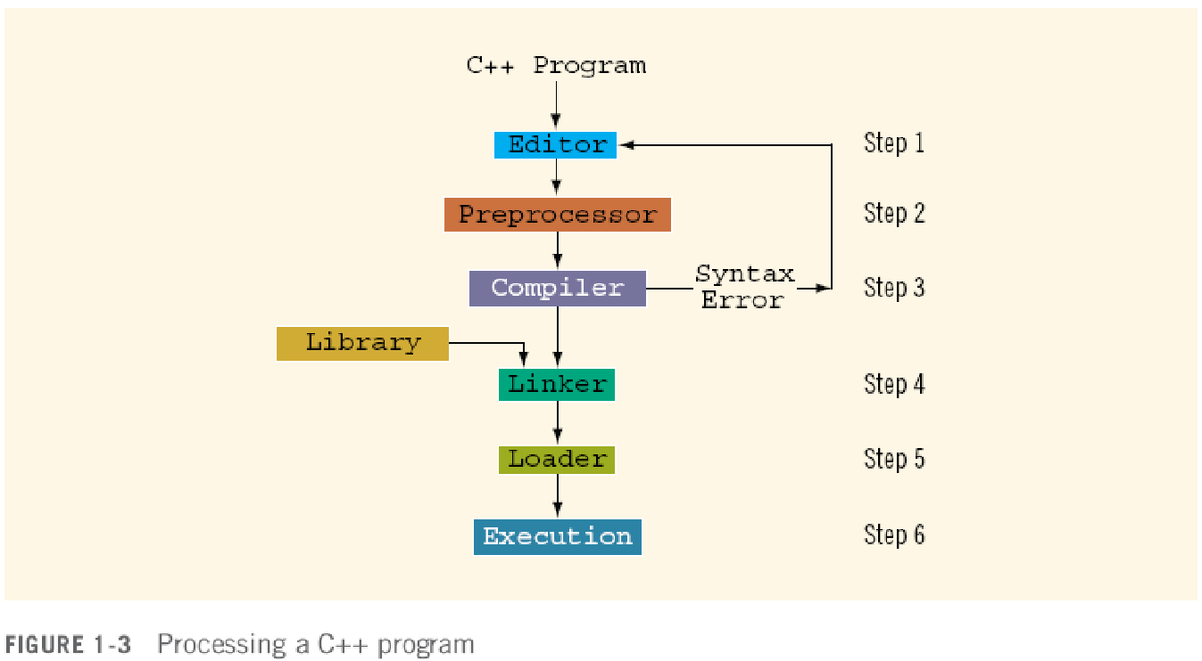
Processing a C++ Program (cont'd.)
C++ Programming: From Problem Analysis to Program Design, Fifth Edition
‹#›

Slide 7
Programming with the Problem Analysis–Coding–Execution Cycle
Programming is a process of problem solving
One problem-solving technique:
Analyze the problem
Outline the problem requirements
Design steps (algorithm) to solve the problem
Algorithm:
Step-by-step problem-solving process
Solution achieved in finite amount of time
C++ Programming: From Problem Analysis to Program Design, Fifth Edition
‹#›

Slide 8
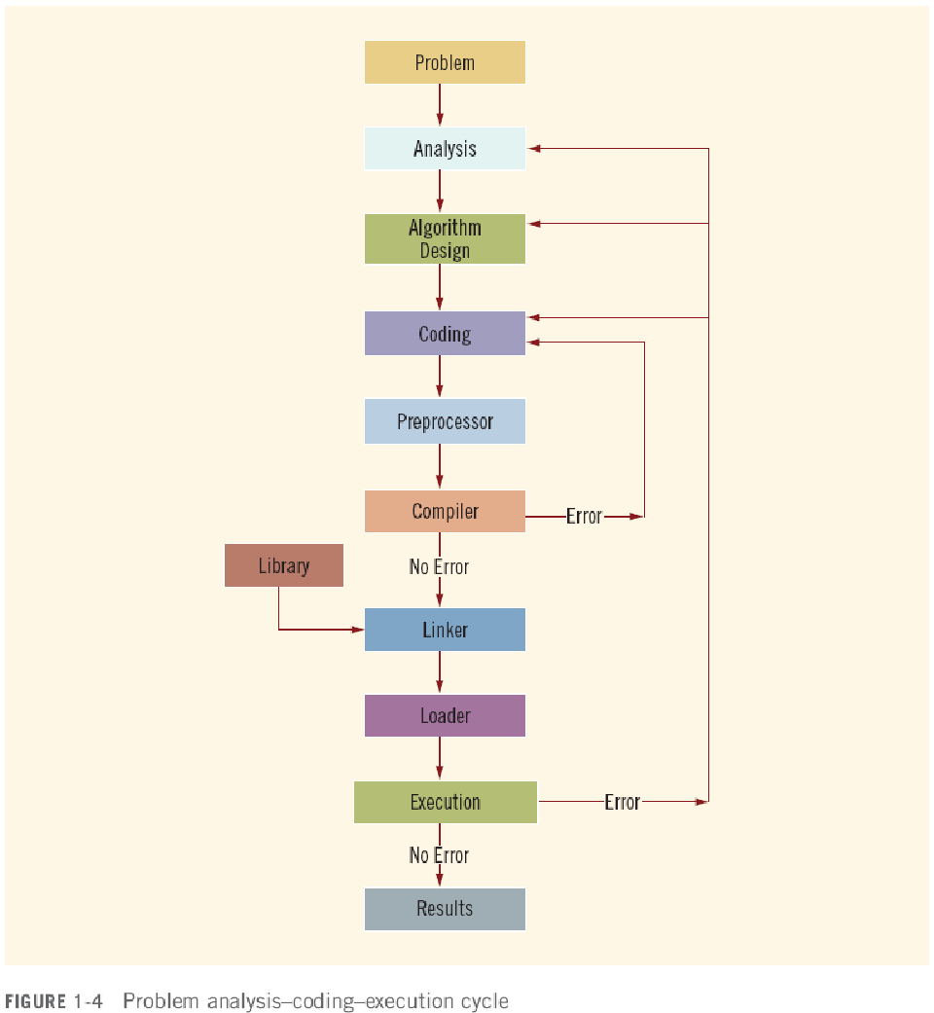
The Problem Analysis–Coding–Execution Cycle (cont’d.)
C++ Programming: From Problem Analysis to Program Design, Fifth Edition
‹#›

Slide 9
The Problem Analysis–Coding–Execution Cycle (cont'd.)
Run code through compiler
If compiler generates errors
Look at code and remove errors
Run code again through compiler
If there are no syntax errors
Compiler generates equivalent machine code
Linker links machine code with system resources
C++ Programming: From Problem Analysis to Program Design, Fifth Edition
‹#›

Slide 10
The Problem Analysis–Coding–Execution Cycle (cont'd.)
Once compiled and linked, loader can place program into main memory for execution
The final step is to execute the program
Compiler guarantees that the program follows the rules of the language
Does not guarantee that the program will run correctly
C++ Programming: From Problem Analysis to Program Design, Fifth Edition
‹#›

Slide 11
Example 1-1
Design an algorithm to find the perimeter and area of a rectangle
The perimeter and area of the rectangle are given by the following formulas:
perimeter = 2 * (length + width)
area = length * width
C++ Programming: From Problem Analysis to Program Design, Fifth Edition
‹#›

Slide 12
Example 1-1 (cont'd.)
Algorithm:
Get length of the rectangle
Get width of the rectangle
Find the perimeter using the following equation:
perimeter = 2 * (length + width)
Find the area using the following equation:
area = length * width
C++ Programming: From Problem Analysis to Program Design, Fifth Edition
‹#›

